Slide 1
Distributed Naming Services Module A5
Distributed & Cloud Computing
Sheheryar Malik, Ph.D.

Slide 2
Naming
Names are used to uniquely identify entities, to refer to locations, to share resources and more
A name can be resolved to the entity it refers to
Name resolution allows a process to access the named entity
To resolve names, it is necessary to implement a naming system
In a distributed system, the implementation of a naming system is itself often distributed across multiple machines.
The mechanism of this distribution plays a key role in the efficiency and scalability of the naming system

Slide 3
Names, Entity, Addresses, Identifiers
Name
string of bits for referring to an entity
Entity
An entity in a distributed system can be practically anything
Entities are the things which can operated on
E.g. Hosts, printers, files, processes, users, mailboxes, Web pages, …
Access point vs address (name of an access point)
An access point is a special kind of entity in a distributed system which gives an access to another entity
The name of an access point is called an address
Names should be location-independent
An entity can offer more than one access point

Slide 4
Names, Entity, Addresses, Identifiers
Identifier
It is an unambiguous name
Human friendly name
An true identifier must has the following properties
Each identifier refers to at most one entity
Each entity is referred to by at most one identifier
Is never re-used (an identifier always refers to the same entity)

Slide 5
Naming Structure
Unstructured Naming
Simple solutions (broadcasting)
Home-based approaches
Distributed Hash Tables (structured P2P)
Hierarchical location service
Structured Naming

Slide 6
Structured Naming

Slide 7
Name Spaces
A graph in which a leaf node represents a (named) entity
A directory node is an entity that refers to other nodes
A directory node contains a (directory) table of (edge label, node identifier) pairs
We can easily store all kinds of attributes in a node, describing aspects of the entity the node represents
Type of the entity
An identifier for that entity
Address of the entity’s location
Nicknames

Slide 8
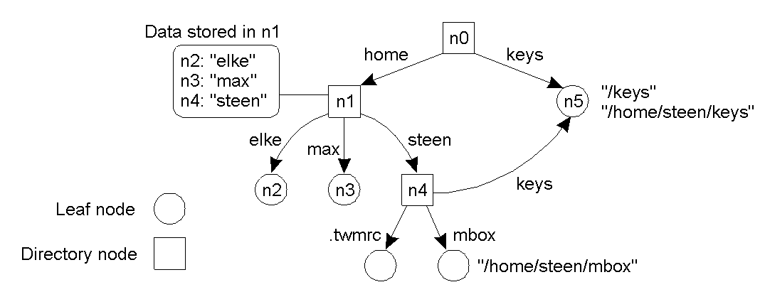
Name Spaces
A general naming graph with a single root node

Slide 9
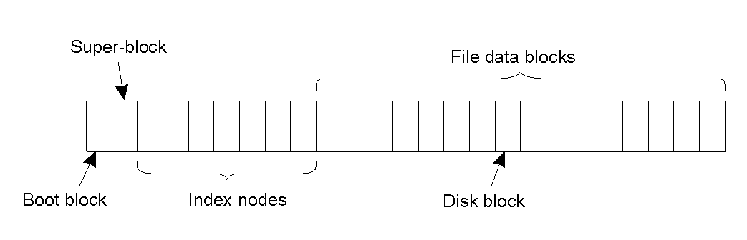
Name Space in UNIX File System
The general organization of the UNIX file system implementation on a logical disk of contiguous disk blocks

Slide 10
Name Resolution
Problem
To resolve a name we need a directory node. How do we actually find that (initial) node?
Solution: Closure mechanism
The mechanism to select the implicit context from which to start name resolution
www.cs.vu.nl: start at a DNS name server
/home/steen/mbox: start at the local NFS file server
0031204447784: dial a phone number
130.37.24.8: route to the VU’s Web server

Slide 11
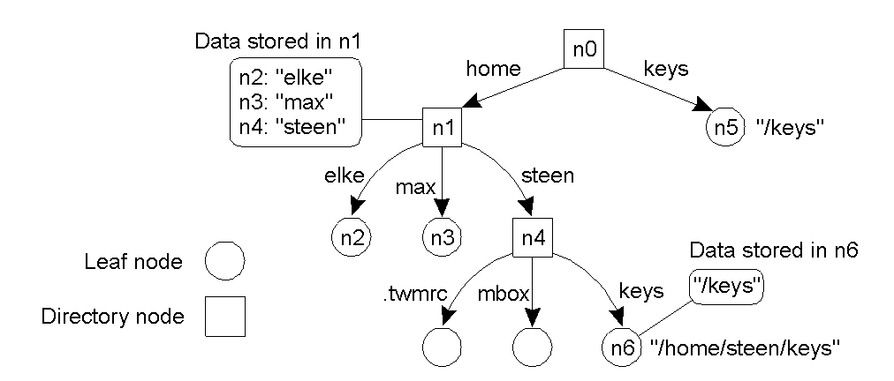
Linking and Mounting
The concept of a symbolic link explained in a naming graph

Slide 12
Linking and Mounting
Information required to mount a foreign name space in a distributed system
The name of an access protocol
The name of the server
The name of the mounting point in the foreign name space

Slide 13
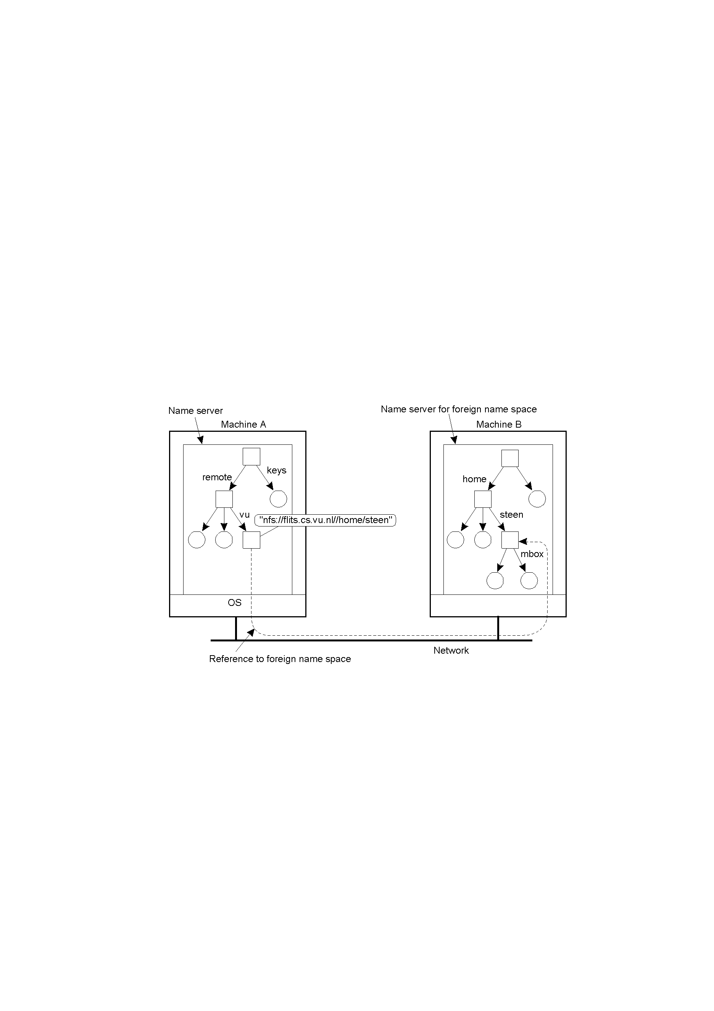
Linking and Mounting
Mounting remote name spaces through a specific process protocol

Slide 14
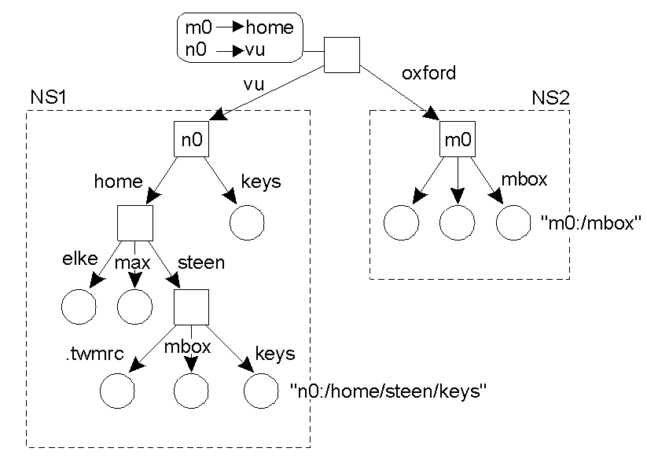
Linking and Mounting
Organization of the DEC Global Name Service

Slide 15
Name Space Implementation
Distribute the name resolution process as well as name space management across multiple machines, by distributing nodes of the naming graph
Distinguish three levels
Global level
Consists of the high-level directory nodes
Main aspect is that these directory nodes have to be jointly managed by different administrations
Administrational level
Contains mid-level directory nodes that can be grouped in such a way that each group can be assigned to a separate administration
Managerial level
Consists of low-level directory nodes within a single administration
Main issue is effectively mapping directory nodes to local name servers

Slide 16
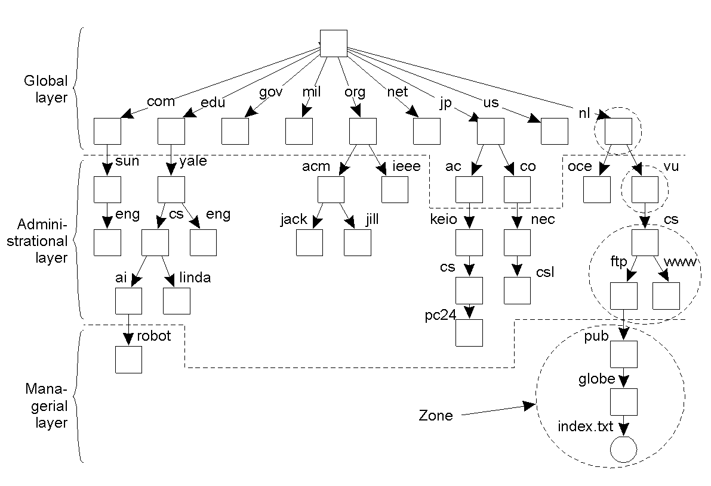
Name Space Implementation
An example partitioning of the DNS name space, including Internet-accessible files, into three layers

Slide 17
Name Space Implementation
Item | Global | Administrational | Managerial
Geographical scale of network | Worldwide | Organization | Department
Total number of nodes | Few | Many | Vast numbers
Responsiveness to lookups | Seconds | Milliseconds | Immediate
Update propagation | Lazy | Immediate | Immediate
Number of replicas | Many | None or few | None
Is client-side caching applied? | Yes | Yes | Sometimes
A comparison between name servers for implementing nodes from a large-scale name space partitioned into a global layer, as an administrational layer, and a managerial layer

Slide 18
Implementation of Name Resolution
Two methods to implement the name resolution
Iterative name resolution
Recursive name resolution

Slide 19
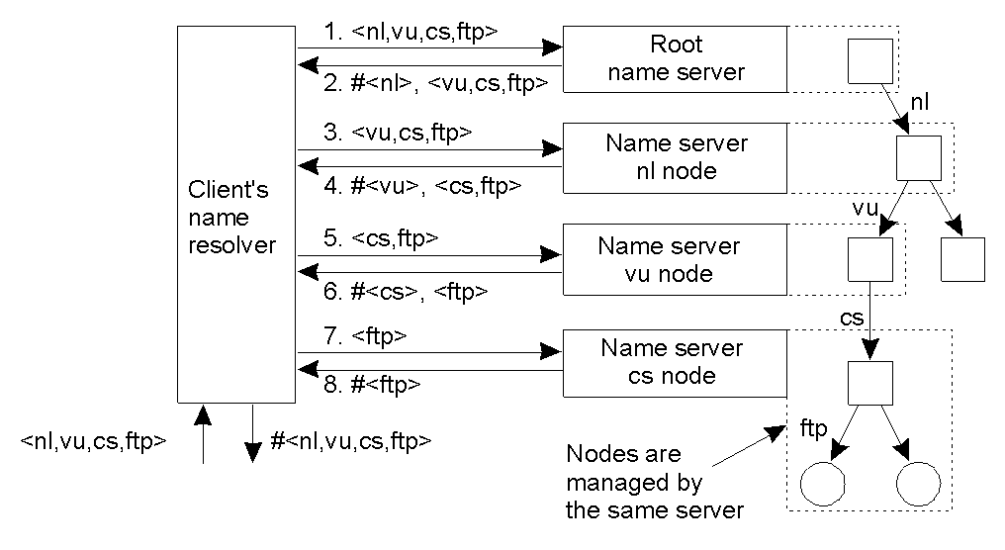
Iterative Name Resolution
The principle of iterative name resolution

Slide 20
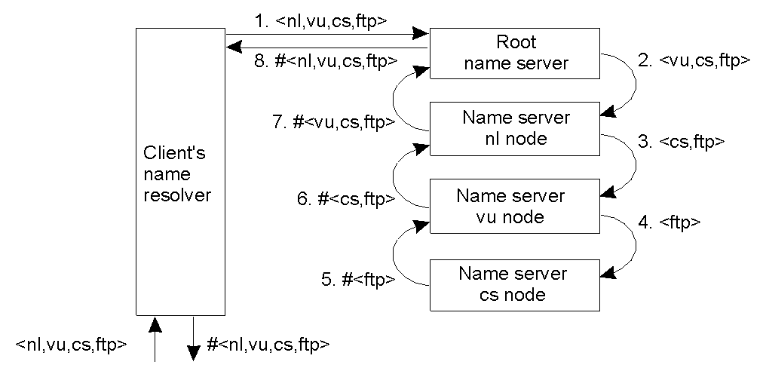
Recursive Name Resolution
The principle of recursive name resolution

Slide 21
Name Resolution Mechanism
Server for node | Should resolve | Looks up | Passes to child | Receives and caches | Returns to requester
cs | <ftp> | #<ftp> | -- | -- | #<ftp>
vu | <cs,ftp> | #<cs> | <ftp> | #<ftp> | #<cs> #<cs, ftp>
ni | <vu,cs,ftp> | #<vu> | <cs,ftp> | #<cs> #<cs,ftp> | #<vu> #<vu,cs> #<vu,cs,ftp>
root | <ni,vu,cs,ftp> | #<nl> | <vu,cs,ftp> | #<vu> #<vu,cs> #<vu,cs,ftp> | #<nl> #<nl,vu> #<nl,vu,cs> #<nl,vu,cs,ftp>
Recursive name resolution of <nl, vu, cs, ftp>.
Name servers cache intermediate results for subsequent lookups

Slide 22
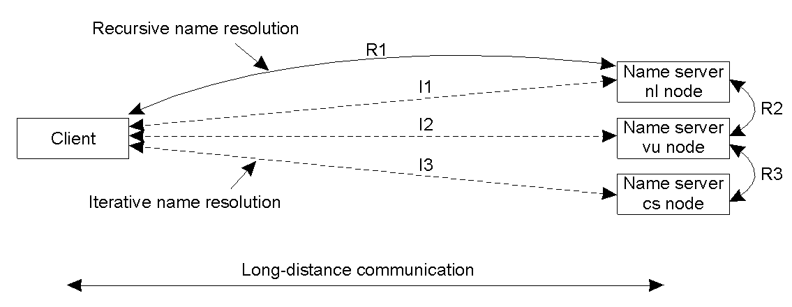
Comparison b/w Name Resolution Implementations
The comparison between recursive and iterative name resolution with respect to communication costs

Slide 23
The DNS Name Space
Type of record | Associated entity | Description
SOA | Zone | Holds information on the represented zone
A | Host | Contains an IP address of the host this node represents
MX | Domain | Refers to a mail server to handle mail addressed to this node
SRV | Domain | Refers to a server handling a specific service
NS | Zone | Refers to a name server that implements the represented zone
CNAME | Node | Symbolic link with the primary name of the represented node
PTR | Host | Contains the canonical name of a host
HINFO | Host | Holds information on the host this node represents
TXT | Any kind | Contains any entity-specific information considered useful
The most important types of resource records forming the contents of nodes in the DNS name space

Slide 24
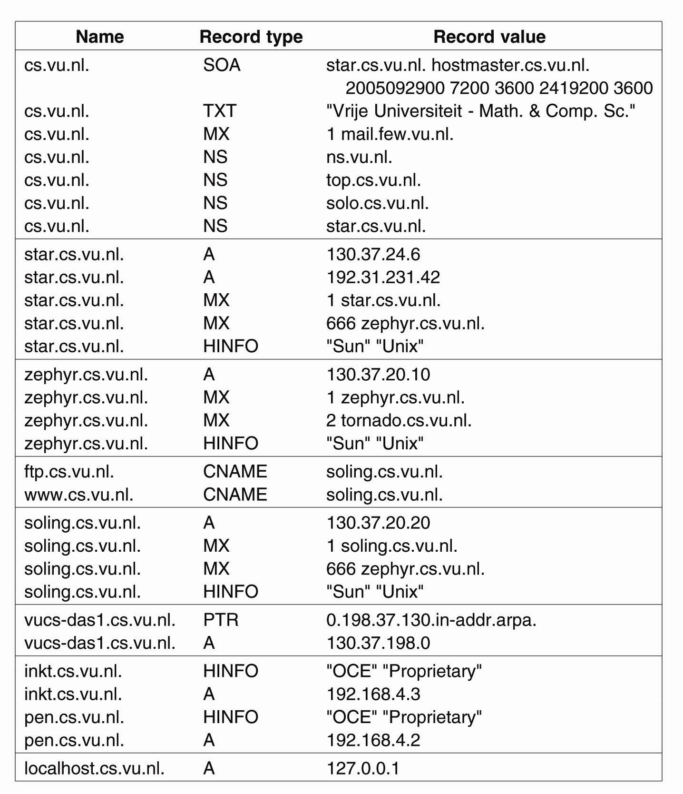
DNS Implementation
An excerpt from the DNS database for the zone cs.vu.nl

Slide 25
DNS Implementation
An excerpt from the DNS database for the zone cs.vu.nl

Slide 26
Internet DNS
Address/name translation
for hosts, routers, applications
Hierarchical name space
distributed database
Distributed set of servers
Application-level protocol
Scalable (through hierarchy & caching)
Replicated for reliability
Requires administration

Slide 27
DNS Example: Mail Address
User
User1@ics.forth.gr
MX for ics.forth.gr ?
Name
Server
Mail Transfer Agent
139.91.157.50
139.91.157.50
TCP
139.91.157.50
IP

Slide 28
Additional DNS-based services
Host aliasing
host with complicated name can have aliases
relay1.west-coast.enterprise.com -> aliases: { enterprise.com, www.enterprise.com}
Mail server aliasing
e-mail addresses need to be mnemonic
bob@hotmail.com, instead of bob@relay1.west-coast.hotmail.com
Load Distribution
replicated web servers
Content Distribution Networks (eg: Akamai)
Busy sites such as cnn.com are replicated over multiple servers

Slide 29
DNS Root Servers
Contacted by local name server that can not resolve a name
Root name server:
contacts authoritative name server if name mapping not known
gets mapping
returns mapping to local name server
13 root name servers worldwide
{a, b, c, … , m}.root-servers.org
Critical part of the Internet infrastructure !

Slide 30
DNS Root Servers Sites
F: Internet Systems Consortium, Inc. Sites:
Ottawa, Toronto
San Jose, San Francisco, Los Angeles
New York City
Rome, Paris, Lisbon, Madrid, Munich
Sao Paulo
Beijing, Seoul, Taipei, Hong Kong, Singapore, Dubai
Moscow
Dubai
Brisbane, Auckland
Monterrey
Johannesburg
Tel Aviv
Jakarta

